Slide 1
Introduction to Bayesian analysis (applied to diagnostic test evaluation)
Julio Alvarez
VISAVET Health Surveillance Centre, Animal Health Department
Universidad Complutense

Slide 2
Quick outline
The problem of evaluation of diagnostic tests: the gold standard dilemma
Overview of Bayesian statistics
Use of Bayesian statistics for evaluation of diagnostic tests

Slide 3
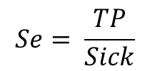
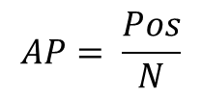
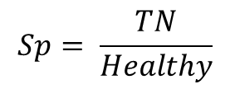
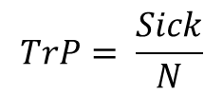
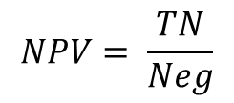
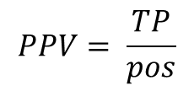
Diagnostic test evaluation
 | Disease + | Disease - | Total
Test +
Test -
Total |  |  | N
Reference
Reference
Pos
$$Se= \frac{TP}{Sick}$$
$$PPV= \frac{TP}{pos}$$
$$AP= \frac{Pos}{N}$$
TN
Sensitivity is the ability of the test to correctly identify diseased individuals
Specificity is the ability of the test to correctly identify healthy individuals
FP
Neg
TP
$$Sp= \frac{TN}{Healthy}$$
$$NPV= \frac{TN}{Neg}$$
$$TrP= \frac{Sick}{N}$$
FN
Sick
Healthy

Slide 4
The problem of diagnostic test evaluation
Typically new/alternative tests are compared with well established/standardized tests (“gold standard”/ “reference test”)
This only informs of the performance of the new test relative to the old one!...
… unless we assume the gold standard is perfect (what we typically do)
Perfect test???

Slide 5

Perfect test????

Slide 6
Case example: mycobacterial diseases
No perfect test (not even close…)
Chronic slow diseases → delayed (non-protective) (humoral) immune response
All known tests lack sensitivity and/or specificity
Usual gold standard is culture… with a sensitivity <50% in multiple cases

Slide 7

Alternatives?
Choose individuals of known status:
Negative: never saw the pathogen (never: different location/epidemiological settings)
Positive: experimental infections
External validity???

Slide 8
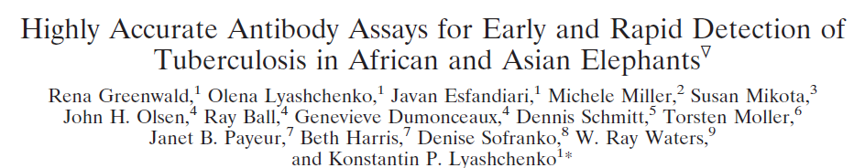
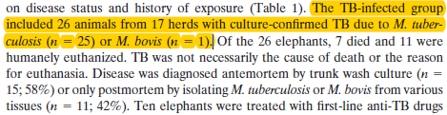
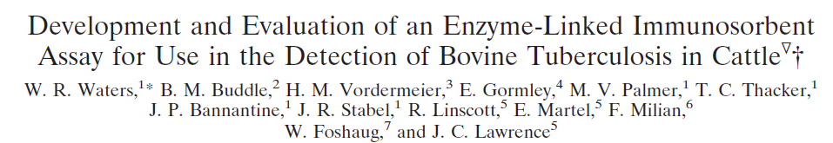
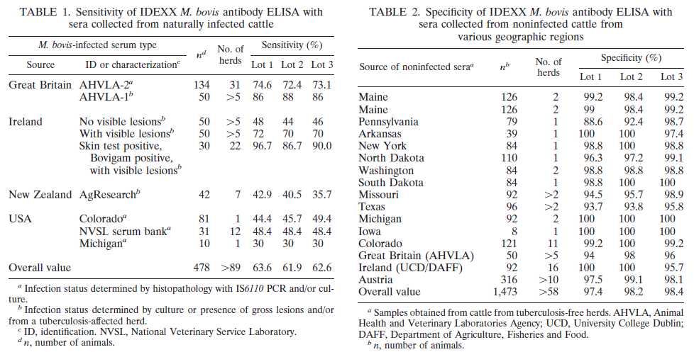
Be careful when using certain terms!

Slide 9
So in reality…
 | Test 2 + | Test 2 - | Total
Test 1 + | a | b | a+b
Test 1 - | c | d | c+d
Total | a+c | b+d | N
Sensitivity 1 and Sensitivity 2???
Specificity 1 and Specificity 2???

Slide 10
Alternatives to the “gold standard”-based approach
“Hui and Walter model”(Hui and Walter, 1980)
“If two tests are applied simultaneously to the same individuals from two populations with different disease prevalences, then assuming conditional independence of the errors of the two tests, the error rates of both tests and the true prevalences in both populations can be estimated by a maximum likelihood procedure”.
Not originally Bayesian: can be solved using ML methods… but require 1) large sample size, 2) assume tests are independent and 3) their accuracy is assumed to be constant across populations

Slide 11
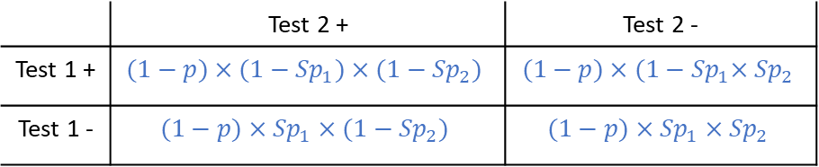
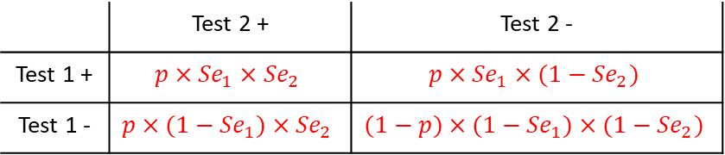
The Hui-Walter paradigm
Hui-Walter model implementation to be further discussed in the next session
 | Test 2 + | Test 2 - | Total
Test 1 + | a | b | a+b
Test 1 - | c | d | c+d
Total | a+c | b+d | N
Diseased population (P)
Non-diseased population (1-P)
 | Test 2 + | Test 2 -
Test 1 + | $$p×{Se}_{1}×{Se}_{2}$$ | $$p×{Se}_{1}×(1−{Se}_{2})$$
Test 1 - | $$p×(1−{Se}_{1})×{Se}_{2}$$ | $$(1−p)×{(1−Se}_{1})×(1−{Se}_{2})$$
 | Test 2 + | Test 2 -
Test 1 + | $$(1−p)×{(1−Sp}_{1})×(1−{Sp}_{2})$$ | $$(1−p)×{(1−Sp}_{1}×{Sp}_{2}$$
Test 1 - | $$(1−p)×{Sp}_{1}×(1−{Sp}_{2})$$ | $$(1−p)×{Sp}_{1}×{Sp}_{2}$$

Slide 12
The Hui-Walter paradigm
T1+T2+= P*Se1*Se2 + (1-P)*(1-Sp1)*(1-Sp2)
T1+T2-= P*Se1*(1-Se2) + (1-P)*(1-Sp1)*Sp2
T1-T2+= P*(1-Se1)*Se2 + (1-P)*Sp1*(1-Sp2)
T1-T2-= P*(1-Se1)*(1-Se2) + (1-P)*Sp1*Sp2
5 parameters to estimate (P, Se1, Se2, Sp1, Sp2) vs. 3 degrees of freedom
Non-identifiable model ☹

Slide 13
The Hui-Walter paradigm
“If two tests are applied simultaneously to the same individuals from two populations with different disease prevalences, then assuming conditional independence of the errors of the two tests, the error rates of both tests and the true prevalences in both populations can be estimated by a maximum likelihood procedure”.
Population 1
T1+T2+: P1*Se1*Se2+(1-P1)*(1-Sp1)*(1-Sp2)
T1+T2-: P1*Se1*(1-Se2)+(1-P1)*(1-Sp1)*Sp2
T1-T2+: P1*(1-Se1)*Se2+(1-P1)*Sp1*(1-Sp2)
T1-T2-: P1*(1-Se1)*(1-Se2)+(1-P1)*Sp1*Sp2
Population 2
T1+T2+: P2*Se1*Se2+(1-P2)*(1-Sp1)*(1-Sp2)
T1+T2-: P2*Se1*(1-Se2)+(1-P2)*(1-Sp1)*Sp2
T1-T2+: P2*(1-Se1)*Se2+(1-P2)*Sp1*(1-Sp2)
T1-T2-: P2*(1-Se1)*(1-Se2)+(1-P2)*Sp1*Sp2
6 parameters to estimate (P1, P2, Se1, Se2, Sp1, Sp2)
vs.
6 degrees of freedom
Identifiable model ☺
But has strong assumptions:
2 populations with different prevalences
Se y Sp constant across populations
Conditional Independence between tests

Slide 14
Conditional Independence?
The result of one test is conditionally independent from the other (knowing if one diseased/non-diseased animal is positive/negative in one test gives no information on whether it will be positive/negative in the other (e.g., knowing that a card is a spades gives no information on whether it is a figure)
Often not true!! (similar tests/tests based on similar principles
Requires adding additional terms to equations (Vacek, 1985)

Slide 15
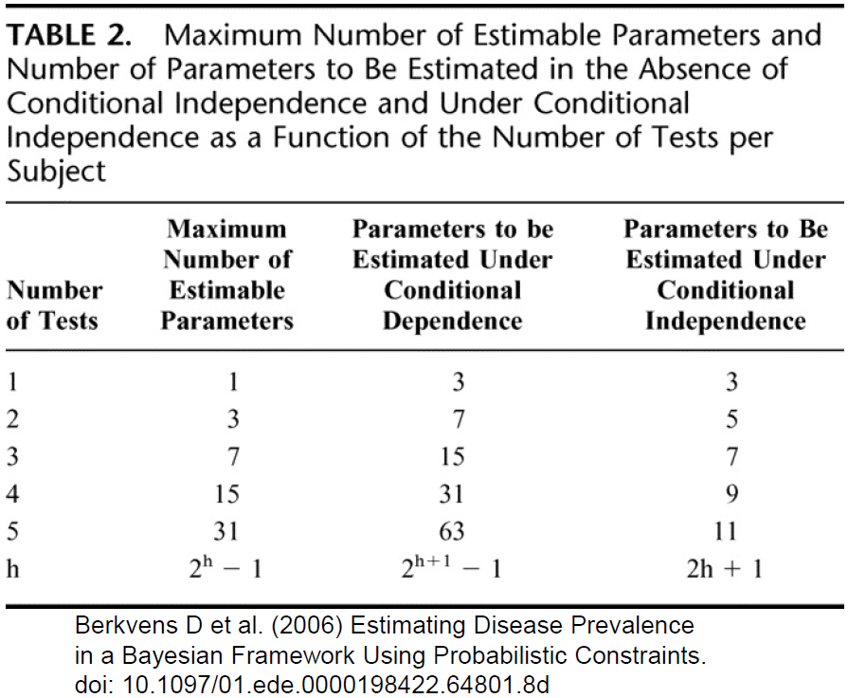
Considering conditional dependence
Number of parameters to estimate increases rapidly as the number of potentially dependent tests increases

Slide 16
Alternatives to the “gold standard”-based approach
If we could only incorporate some prior knowledge… we could get rid of large sample theory assumptions and “guide” our models
We typically have some information on diagnostic performance (i.e., test sensitivity is >20%)
We typically have some information on disease prevalence (i.e., proportion of infected is <50%)

Slide 17

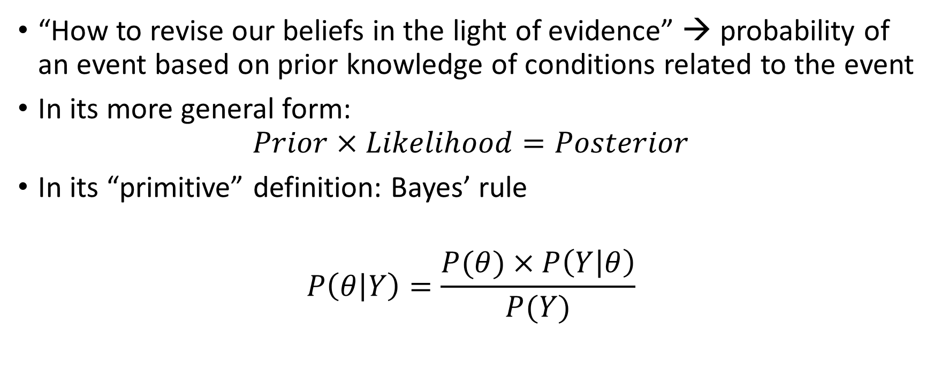
Bayesians to the rescue!
“How to revise our beliefs in the light of evidence” → probability of an event based on prior knowledge of conditions related to the event
In its more general form:
$$Prior×Likelihood=Posterior$$
In its “primitive” definition: Bayes’ rule
$$P\left(θ | Y\right)=\frac{P(θ)×P\left(Y | θ\right)}{P(Y)}$$

Slide 18
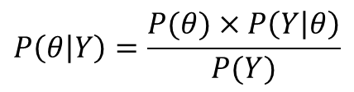
Bayesian applied to diagnostic test evaluation
Joseph et al. (1995) Bayesian estimation of disease prevalence and diagnostic test evaluation in the absence of a gold standard
Targets
Prevalence π = P(D+)
Sensitivity Sei = P(Ti + |D+)
Specificity Spi = P(Ti − |D−)
Prior knowledge (beta distributions)
π ∼ Beta(aπ, bπ)
Sei ∼ Beta(aSei , bSei )
Spi ∼ Beta(aSpi , bSpi )
$$P\left(θ | Y\right)=\frac{P(θ)×P\left(Y | θ\right)}{P(Y)}$$

Slide 19
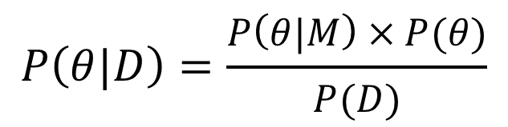
Application of Bayes’ rule or Bayesian statistics?
Probabilities referred to frequency of events
In a more general framework: from “probability of the data given the model” (classic significance testing) to “probability of the model given the data” through an extension of Bayes’ theorem.
$$P\left(θ|D\right)=\frac{P\left(θ|M\right)×P(θ)}{P(D)}$$

Slide 20
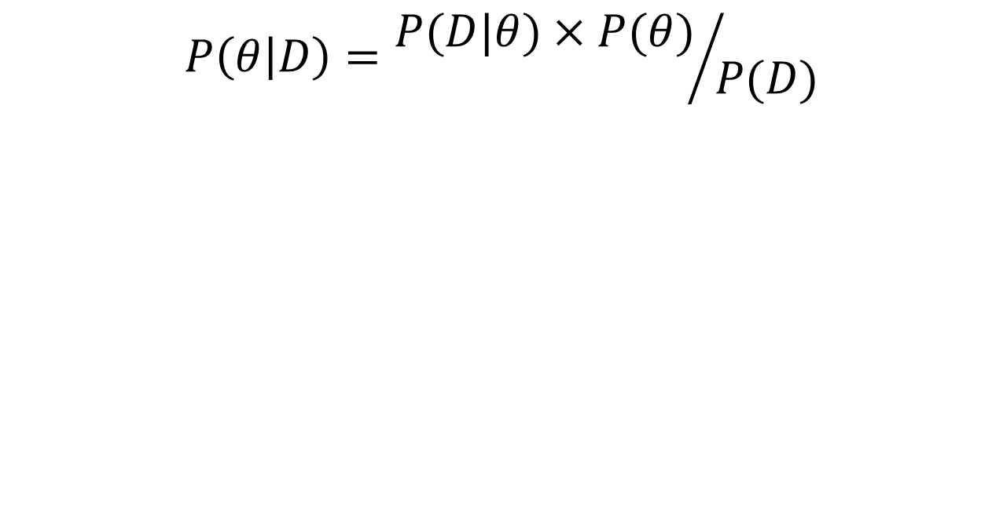
Bayes’ theorem applied to models
$$P\left(θ | D\right)={P(D|θ)×P(θ)}/{P(D)}$$
Posterior
Likelihood
Evidence
Prior

Slide 21
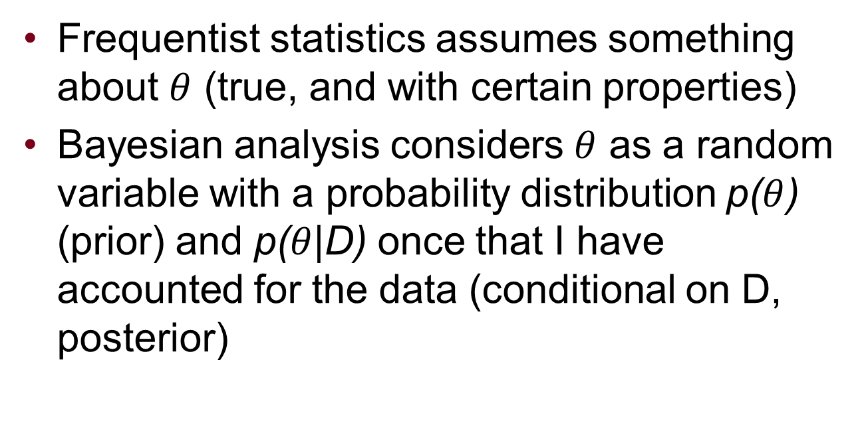
Bayesian “crucial step”
Frequentist statistics assumes something about $θ$ (true, and with certain properties)
Bayesian analysis considers $θ$ as a random variable with a probability distribution p($θ$) (prior) and p($θ$|D) once that I have accounted for the data (conditional on D, posterior)

Slide 22
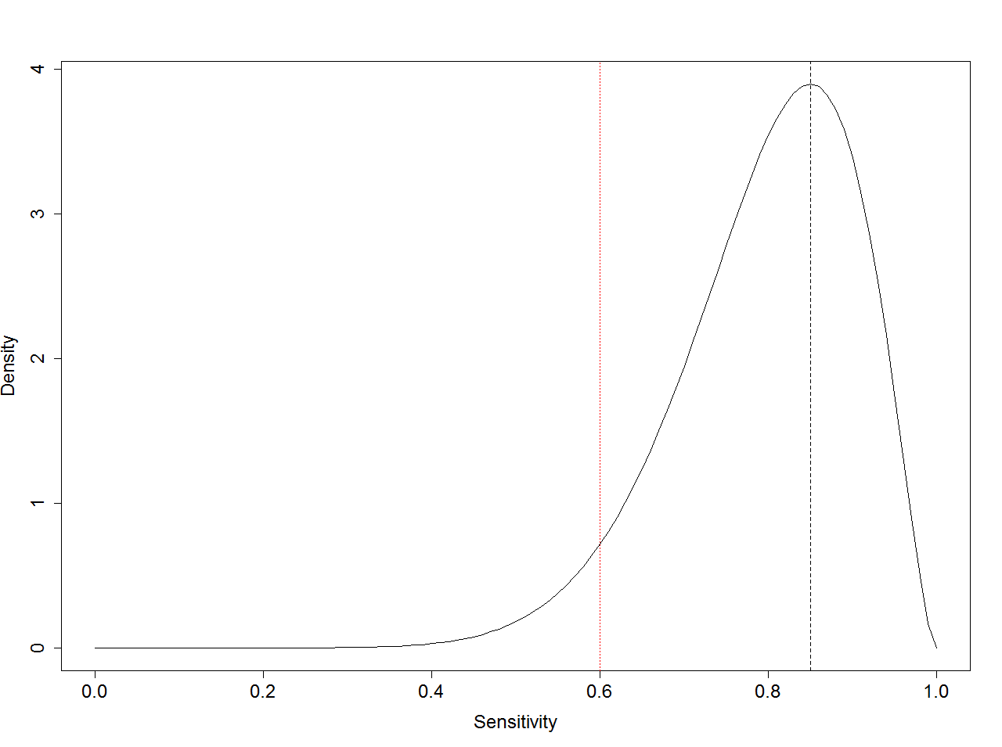
What is the sensitivity of test X?
Option 1: 85%
Option B:
Typically ~85%
Usually >60%

Slide 23
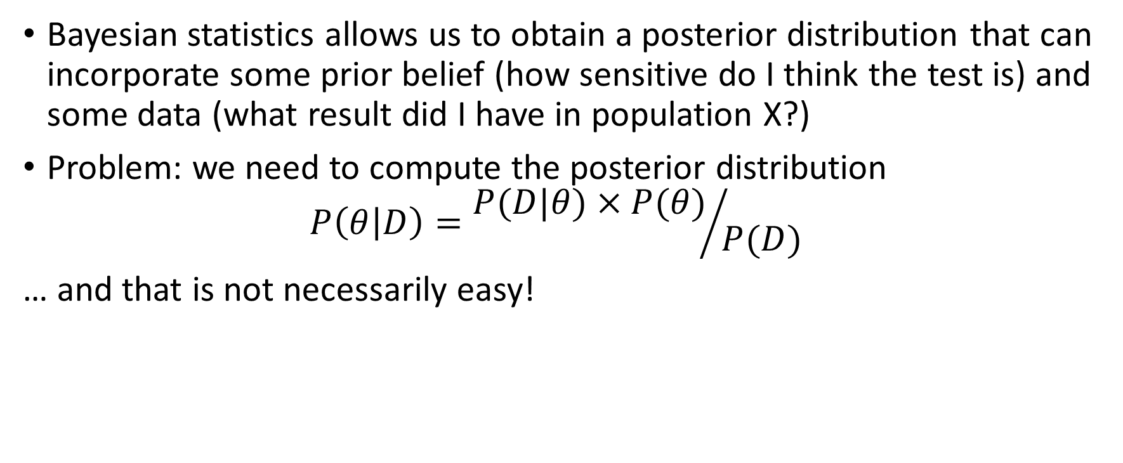
So it is a perfect match!!
Bayesian statistics allows us to obtain a posterior distribution that can incorporate some prior belief (how sensitive do I think the test is) and some data (what result did I have in population X?)
Problem: we need to compute the posterior distribution
$$P\left(θ | D\right)={P(D|θ)×P(θ)}/{P(D)}$$
… and that is not necessarily easy!

Slide 24
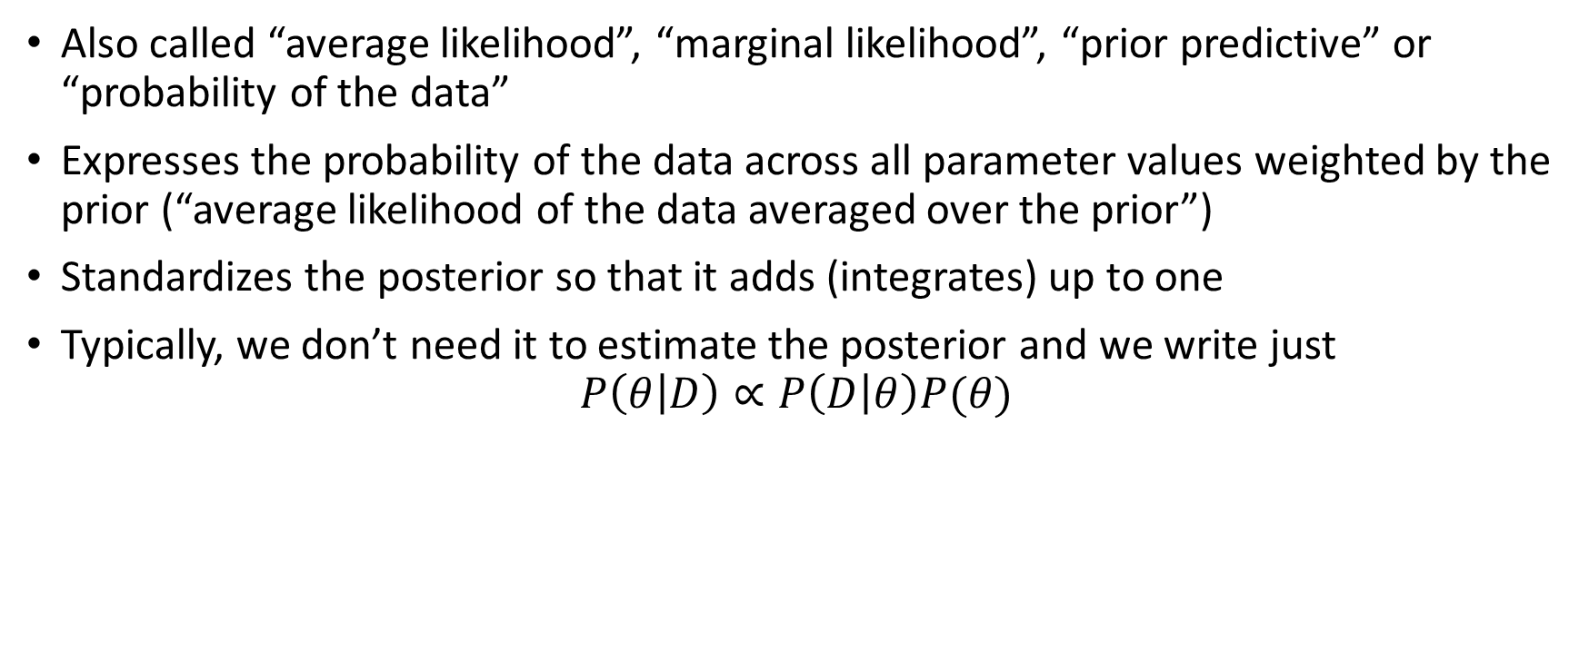
A word about the evidence
Also called “average likelihood”, “marginal likelihood”, “prior predictive” or “probability of the data”
Expresses the probability of the data across all parameter values weighted by the prior (“average likelihood of the data averaged over the prior”)
Standardizes the posterior so that it adds (integrates) up to one
Typically, we don’t need it to estimate the posterior and we write just
$$P\left(θ | D\right)∝P\left(D | θ\right)P(θ)$$

Slide 25
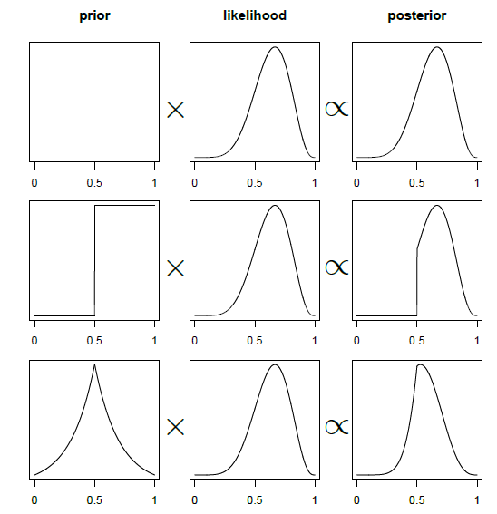
Posterior is a function of the prior and the likelihood

Slide 26
So how do we estimate the posterior?
Other than analytical mathematics (always unattractive for vets, and sometimes non-computable depending on the model) there are several numerical techniques, such as:
Grid approximation
Quadratic approximation
Markov Chain Monte Carlo (beloved MCMC) → several tools developed in the last decades that allow its easy implementation, e.g.
Bayesian inference Using Gibbs Sampling: BUGS (1997) → WinBUGS, OpenBUGS
Just Another Gibbs Sampler: JAGS (2007)
Stan (based on Hamiltonian/hybrid Monte Carlo)

Slide 27
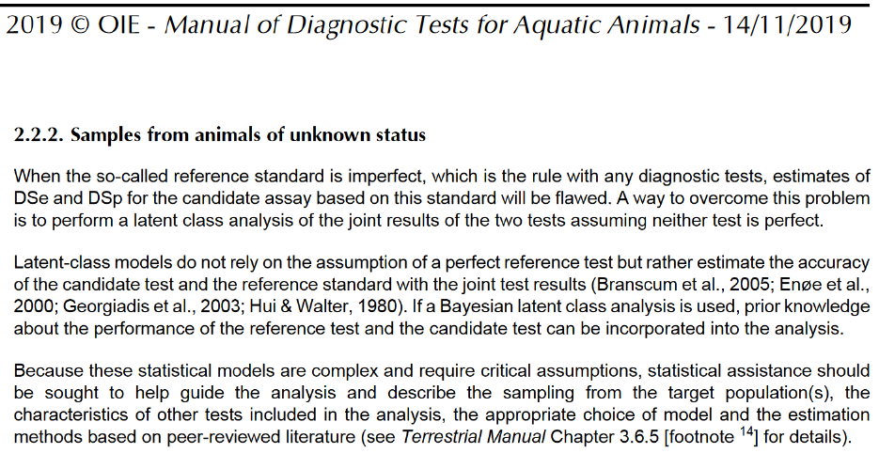
Nowadays
BLCMs widely applied for the evaluation of (veterinary) diagnostic tests: endorsed by the WOAH

Slide 28
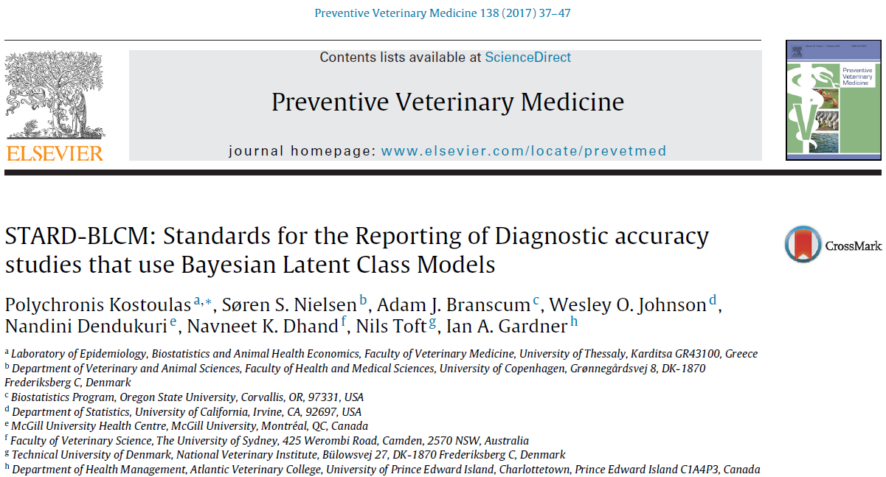
Nowadays
Guidelines available for adequate reporting of the use of BLCMs in the context of diagnostic test evaluation

Slide 29
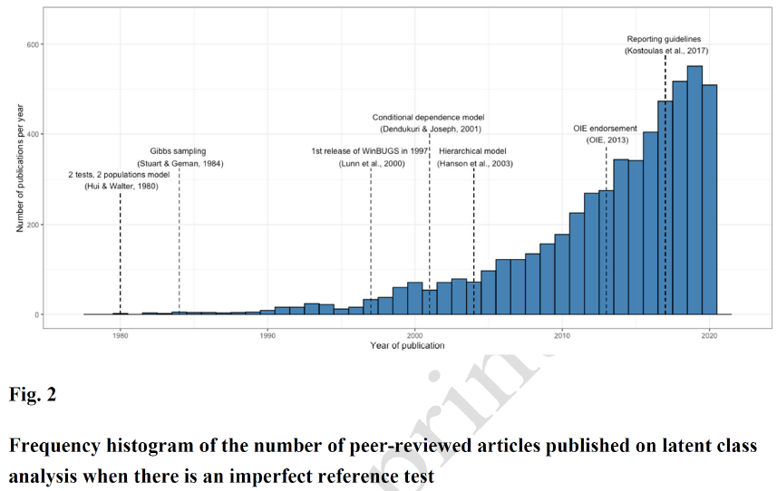
Nowadays

Slide 30
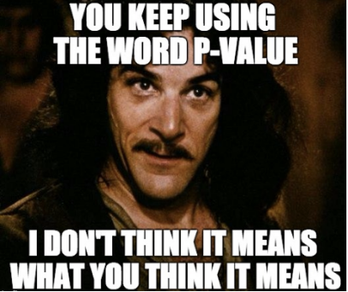
Frequentist or Bayesian?
Criticism to Bayesian approaches
Overreliance on priors → cheating!
Lack of robustness when data and prior conflict
Criticism to frequentist approaches
Inefficiency/inflexibility/lack of realism → multiple dependences in spite of not using priors!
99.9% there is prior information available… why not using it?
Less intuitive: “Bayesian interpretation”
Notes:
Choice of prior distribution is just another assumption that is explicitly declared and formally checked!

Slide 31
References
Hui, S. L., & Walter, S. D. (1980). Estimating the error rates of diagnostic tests. Biometrics, 167-171.
Vacek, P. M. (1985). The effect of conditional dependence on the evaluation of diagnostic tests. Biometrics, 959-968.The effect of conditional dependence on the evaluation of diagnostic tests
Joseph, L., Gyorkos, T. W., & Coupal, L. (1995). Bayesian estimation of disease prevalence and the parameters of diagnostic tests in the absence of a gold standard. American journal of epidemiology, 141(3), 263-272.
Spiegelhalter, D. J., Thomas, A., Best, N. G., & Lunn, D. J. (2002). WinBUGS: Bayesian Inference Using Gibbs Sampling Manual, Version 1.4. London: Imperial College; Cambridge, UK: MRC Biostatistics Unit.
Enøe, C., Georgiadis, M. P., & Johnson, W. O. (2000). Estimation of sensitivity and specificity of diagnostic tests and disease prevalence when the true disease state is unknown. Preventive veterinary medicine, 45(1-2), 61-81.
Plummer, M. (2003, March). JAGS: A program for analysis of Bayesian graphical models using Gibbs sampling. In Proceedings of the 3rd international workshop on distributed statistical computing (Vol. 124, No. 125.10, pp. 1-10).
Toft, N., Innocent, G. T., Gettinby, G., & Reid, S. W. (2007). Assessing the convergence of Markov Chain Monte Carlo methods: an example from evaluation of diagnostic tests in absence of a gold standard. Preventive veterinary medicine, 79(2-4), 244-256.
Kostoulas, P., Nielsen, S. S., Branscum, A. J., Johnson, W. O., Dendukuri, N., Dhand, N. K., . . . & Gardner, I. A. (2017). STARD-BLCM: Standards for the Reporting of Diagnostic accuracy studies that use Bayesian Latent Class Models. Preventive veterinary medicine, 138, 37-47.

